Slide 1
Forever Campaign
Look Book

Slide 2
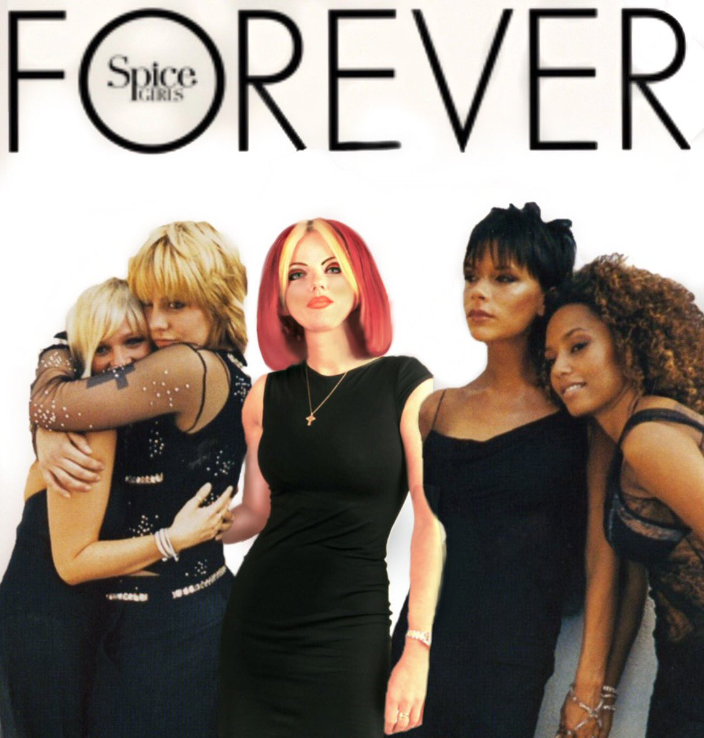
Forever Artwork
Red eye for Emma and a space left for ghost Geri
Credit to @coolbritaniaart – they had the same idea as us years before. Check them out.

Slide 3
Reunion tour costumes
Where did they buy those sequin materials? This is not VB London fashion week

Slide 4
Aprilia World Service
The Aprilia world service bikes that the girls got sued for an ended up setting case law in the UK

Slide 5
Goodbye
A top charting single. Not a charting topping fringe for Mel C

Slide 6
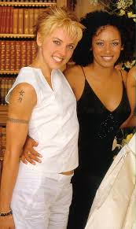
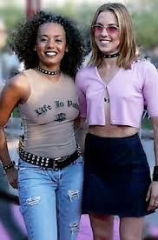
Mel C haircuts
She really experimented

Slide 7
Brit Awards 2000
The 2000 Brit awards. We remember the Spice Girls fashion being cool and laid back. No effort…. We were wrong
Geri didn’t join them on stage; despite performing at the ceremony

